Slide 1
Semantic Web Mining
Finding Ar’s in linked open dataset
By-
Bryceleen D’souza(7057) Leon Suraj D’souza(7058) Mugesh Nadar(7087)

Slide 2
INTRODUCTION:
What is Semantic Web?
What is linked data?
What are association rules?

Slide 3

Semantic Web? Huh?
Web 3.0
Promotes Common Data Format for exchange of information.
Promotes Open Formats →
Aims to make the Web a Machine Readable Entity

Slide 4
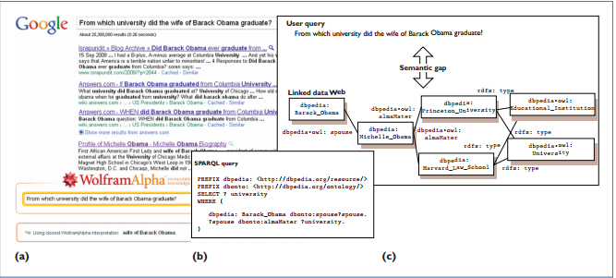
MIND THE GAP

Slide 5
Problem Statement
An algorithm, named Semantic Web Apriori, has been proposed which has considered challenges of Semantic Web Mining and without the end user involvement, mines ARs directly from a single semantic web dataset. The problem statement includes collecting and connecting them so that all data appear as a single and central dataset and then using existing methods to mine ARs from the generated dataset.

Slide 6
LITERATURE SURVEY
Association Rule Mining (ARM) algorithms are of two types : Apriori based and FP-based.
LD datasets are convertible to directed graphs but this is not suitable for ARM
However, ARs are mined now from semantic web data using mining patterns the user provides based on SPARQL.

Slide 7
LITERATURE SURVEY
Conversion into graphs doesn’t work because unlike traditional methods, TRANSACTIONS are not well defined entities in the Semantic Web
Also Graph vertices are unique and discovering sub-graph redundancy is really not possible

Slide 8
SCOPE
Preliminary experiments have been performed on this semantic data showing promising results and proving the efficiency, robust, and usefulness of the used approach.
Knowledge representation of the web.
Integration of databases in the knowledge web.
Scalability of knowledge-intensive web services

Slide 9
CHALLENGES
Large amount of Redundant data found.
Reliable data needs to be found.
Contrasting/Related data found.
Too much data on any topic.

Slide 10
Competitive Analysis/Similar System
1. LiDDMT
Comes Close by mining data from SW using WEKA
Developed as a Research Project for Ph.D. by a group of university professors
Doesn’t mine Association Rules, Does clustering only

Slide 11



Where’s the Dataset?
Dbpedia
Factbook
Eurostat

Slide 12
Data Structure To Be Used
Data Stored as triples → requires three entities → 3D Cube (3D Array)!
Strength : Faster Traversal
Weakness : Memory Wastage, Can’t represent all triples (203953773 * 3), Can’t easily trace possible relationships if any exist already
Weaknesses > Strengths! Booooooo!
SUBJECT
PREDICATE
OBJECT

Slide 13
Data Structure We will use!
LinkedList like Data Structure
Object ID
Predicate ID | Subject List
 | (Essentially Pointers to List)

Slide 14
Semantic Web Apriori Algorithm

Slide 15
Semantic Web Apriori
Generate 2 LargeItemset
Mine AR’s

Slide 16
SWAPriori
Inputs:
Dataset
Minimum Support
Minimum Confidence
Outputs:
Large Data-Item
Association Rule

Slide 18
Generate2 Large DataItem
Inputs:
List of object info instances
Minimum Support
Outputs:
List of large Itemset

Slide 20
Association Rule
Inputs:
All large itemset
Minimum Confidence
Outputs:
Association Rules

Slide 22
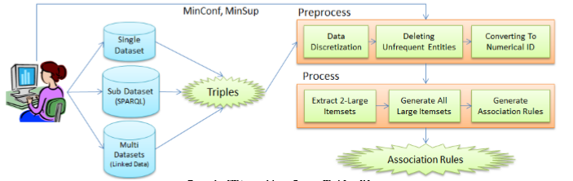

Slide 23
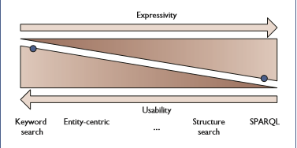
Technology
SPARQL, Jena, Turtle, RDF
SPARQL allows to query Ontologies, Data Sets while Jena provides the Java Powered platform independency required.
Turtle and RDF are used to represent Ontologies

Slide 24
THANK YOU!

